Slide 1
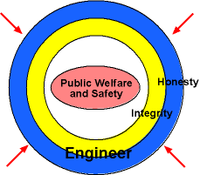
Engineer's Obligation to People/Society
In today's world of lawsuits and accounting scandals all engineers need to uphold a strong ethics standard. One of the best models for ethics is the The Institute of Electrical and Electronics Engineers, Inc. "Code of Ethics" that was approved by he IEEE Board of Directors August 1990.
"1. While performing services, the engineer's foremost responsibility is to the public welfare." If there is a "most important rule," this is it. The next two points elaborate on this principle. "2. Engineers shall approve only those designs that safeguard the life, health, welfare and property of the public while conforming to accepted engineering standards.
Fig. 1 An engineer's honesty and integrity provide a shield of protection to the public welfare and safety.

Slide 2
3. If an engineer's professional judgment is overruled resulting in danger to the life, health, welfare or property of the public, the engineer shall notify his/her employer or client and any authority that may be appropriate." "4. Engineers shall be objective and truthful in professional reports, statements, or testimonies and provide all pertinent supporting information relating to such reports, statements, or testimonies." This is one of those obvious ones: "be completely honest.“
5. Engineers shall not express a professional opinion publicly unless it is based upon knowledge of the facts and a competent evaluation of the subject matter." People depend on knowledgeable professionals to form judgments on subjects in which they have limited information or expertise. Thus, it is important that engineers do not offer any public statement that is not entirely based upon facts and sound engineering principles.

Slide 3
6. Engineers shall not express a professional opinion on subject matters for which they are motivated or paid, unless they explicitly identify the parties on whose behalf they are expressing the opinion, and reveal the interest the parties have in the matters.
This is to avoid bribery, dishonesty, and slander in the engineering business. People have a right to know why an engineer may be eager to endorse a product, project, or idea: whether it is based on a paid agreement, or an honest professional opinion that the product, project, or idea is superior. "7. Engineers shall not associate in business ventures with nor permit their names or their firms' names to be used by any person or firm which is engaging in dishonest, fraudulent, or illegal business practice." This is sometimes termed the "clean hands" rule. Simply stated, maintaining clean and honest business relations is something engineers owe to their customers and employers; it is also vital to the integrity of the profession.

Slide 4
"8. Engineers who have knowledge of a possible violation of any of the rules listed in this and the following two parts shall provide pertinent information and assist the state board in reaching a final determination of the possible violation." Our foremost obligation is to the public welfare. If it is necessary to be a whistle blower to protect that, then so be it

Slide 5
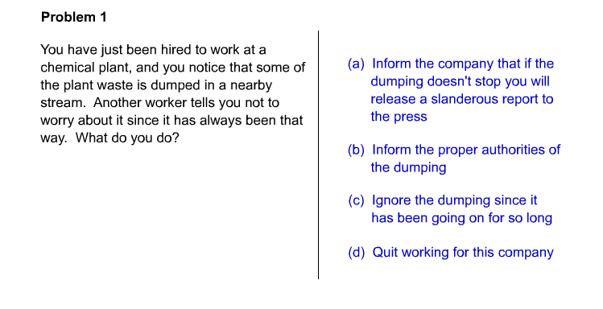

Slide 6
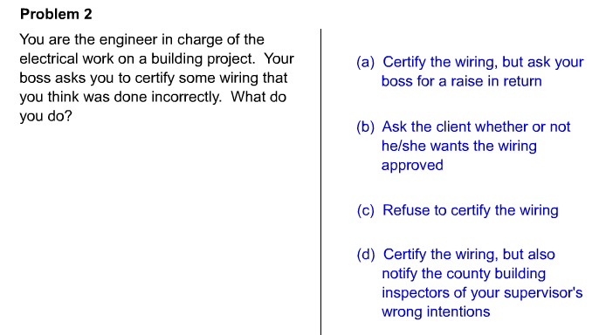

Slide 7
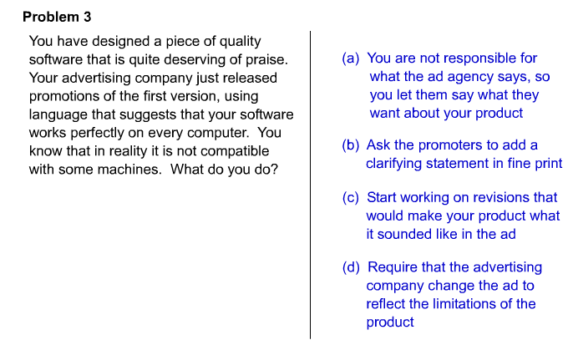

Slide 8
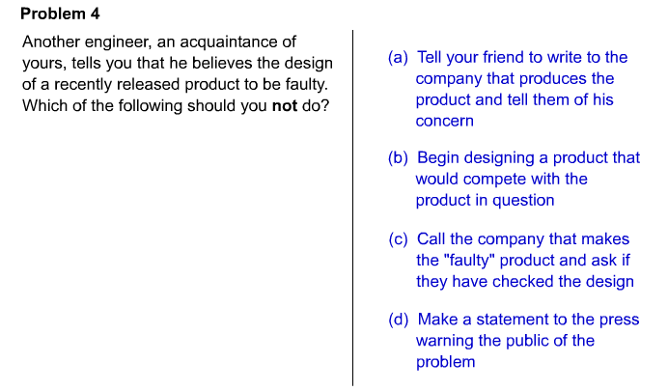

Slide 9
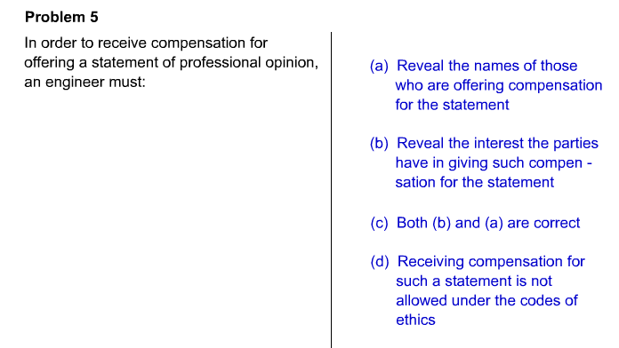

Slide 10
